Slide 1
Lambert Beach Resort
Tortola, British Virgin Islands

Slide 2
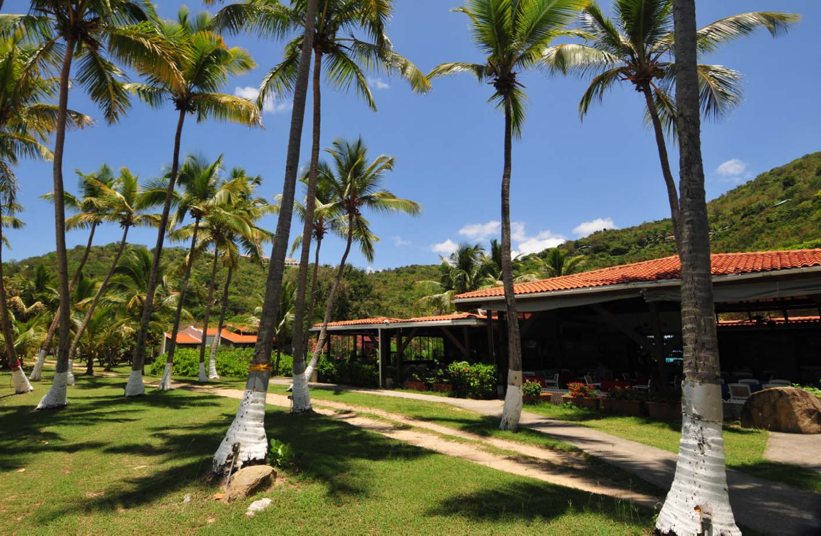

Slide 3
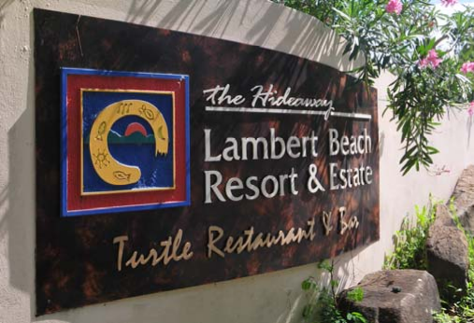
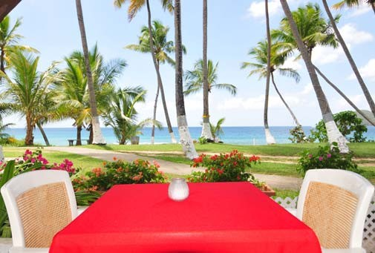
Introduction
Lambert Beach Resort is a planned destination resort located on the northeast shore of Tortola ‐ the largest and most populous island within the British Virgin Islands (BVI). The property was originally assembled in the 1980s and currently extends to approximately 47.5 acres of freehold land.
The sale of Lambert Beach Resort offers investors a chance to acquire an existing established resort in one of the Caribbean’s most sought after locations. The mix of beachfront hotel, villas, condominiums and undeveloped lots gives a new owner the opportunity to generate immediate income from the property whilst considering longer term development potential.
One of the property’s main assets, Lambert Beach is a wonderful stretch of white sand recognised as being amongst the most picturesque beaches in the BVI. The resort owns the entire length of the beach giving approximately 1,500 feet of frontage. The property sits within a natural amphitheatre setting with the land rising sharply to over 300 feet away from the sea. The hotel buildings and the majority of the Resort’s condominiums are located on level ground adjacent to the beach.
The Resort is accessed via a public highway leading from the main East to West highway that links the Terrance B. Lettsome International Airport at Beef Island (approximately 15 minute drive) and Road Town, the capital (approximately 20 minute drive). The airport provides the main gateway into the BVI with direct flights to Puerto Rico, St Maarten and Antigua with onward connections to the US and Europe.

Slide 4
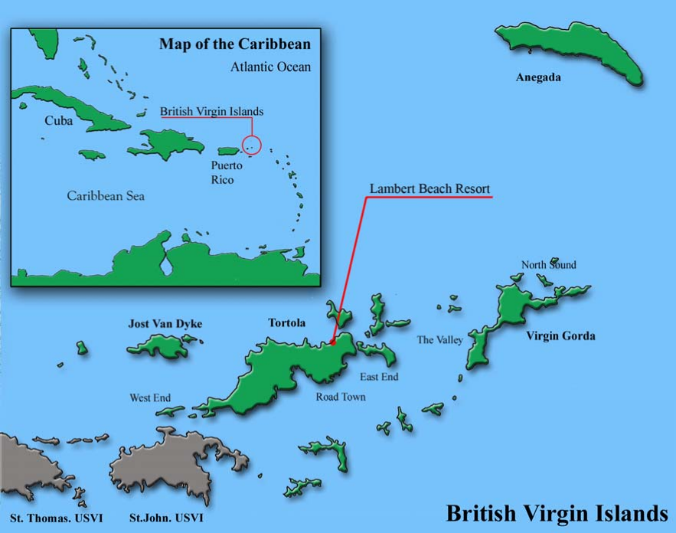
British Virgin Islands
The BVI comprise a group of more than sixty islands, rocks and cays situated approximately 50 miles to the east of Puerto Rico and 90 miles to the north west of St. Martin. The islands of St. Thomas and St. John in the United States Virgin Islands (USVI) are situated to the west and south west; the island of St. Croix, also in the USVI, is located 40 miles to the south.
There are four main inhabited islands in the BVI: Tortola, Virgin Gorda, Anegada and Jost Van Dyke. A further 12 of the smaller islands and cays have a permanent population. The islands are surrounded by sheltered waters; the Sir Francis Drake Channel to the south of Tortola provides excellent protected sailing waters that stretch from St John (USVI) in the west to Virgin Gorda in the east.
With a total land area of only 59 square miles, the BVI is one of the smallest countries in the Caribbean.
However, the extensive coastline surrounding the islands provides a sizeable coastal economic zone. The climate is sub‐tropical with typical year round temperatures ranging from 80°F to 95°F. Rainfall is low throughout the islands with semi‐arid conditions to the east and more lush conditions to the west.

Slide 5
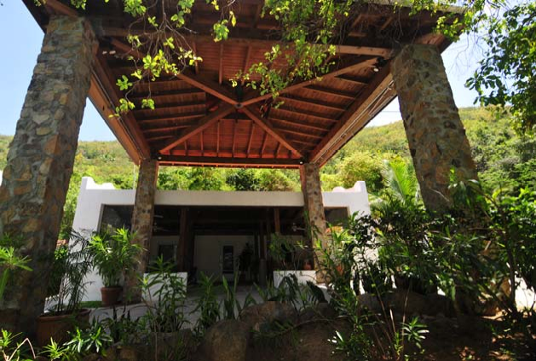
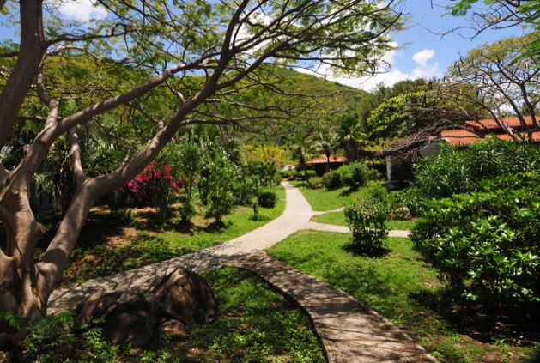
Property Description
Lambert Beach Resort was originally assembled in the 1980s and development as a resort was commenced in the mid 1990s by Elizabeth Beach Resorts which saw the hotel opening in February 1998. The following 10 year period saw completion of the condominiums and villa buildings with some of the individual units and lots being sold to third parties during this time. The entire Resort was sold to Greenfield Property Holdings in 2006.
The whole property is held freehold and comprises four main components described below and shown on the plan on the next page. Please also refer to the schedule of parcels in the Appendices.
Lambert Beach Resort Hotel ‐ A 38 key hotel with restaurant, bar and function room;
5 Lambert Beach Resort Villas ranging in size from two to four bedrooms;
33 Lambert Beach Resort Condominiums currently let or available for rent;
45 additional lots containing approximately 27.6 acres of undeveloped land.

Slide 6
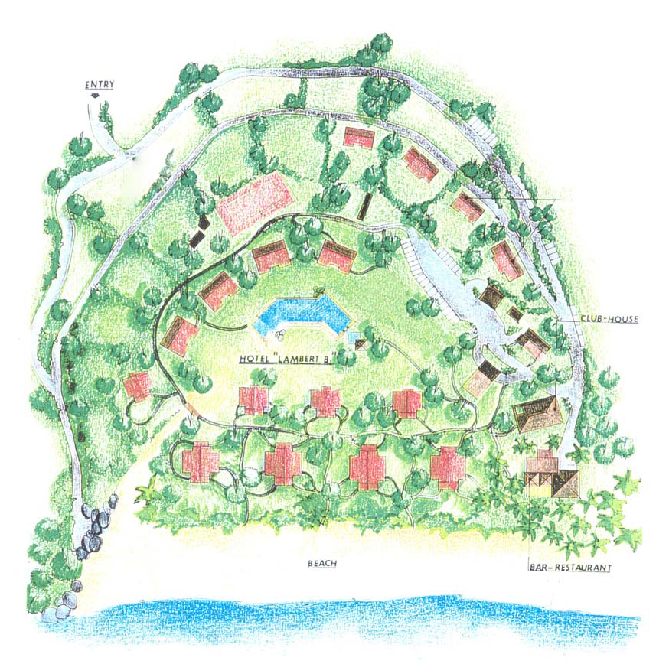
Lambert Beach Resort Hotel
The Lambert Beach Resort Hotel is a Mediterranean inspired resort hotel comprising a series of predominantly single storey buildings laid out over approximately 14.4 acres of landscaped grounds. The hotel is located at the centre of the property adjacent to the beach.
There are a number of walkways and paths through the attractively landscaped grounds. The buildings are set back a short distance from the beach, which has allowed the growth of sea grape to act as a natural wind break and for a line of palm trees to give shade from the Caribbean sun.
Hotel Guestrooms
There are 38 dedicated guestrooms comprised within eight attractive villa style buildings located in two rows of four separated by a central landscaped pathway. The row closest to the beach contains a total of 22 guestrooms with 16 beach facing and 6 garden facing rooms. Within the second row there are three buildings currently used for hotel accommodation comprising 12 guestrooms, all of which face the beach.
Historic artist impression showing existing hotel layout

Slide 7
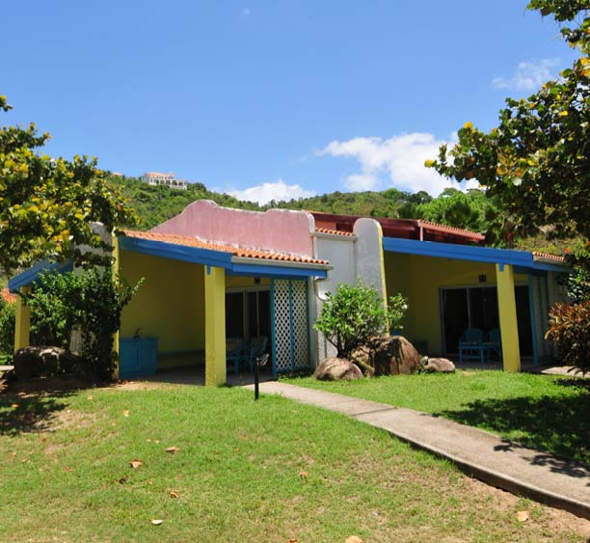
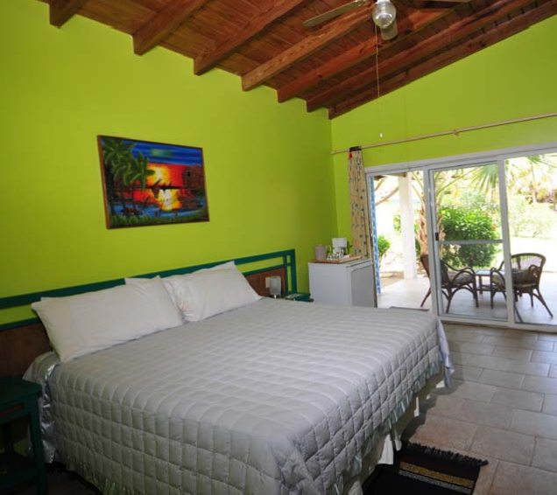
The fourth building in the second row and located furthest from reception is currently not used for hotel guests and is configured as one 2‐bed unit with 2 bathrooms and a kitchen and two hotel guestrooms (not used).
All of the hotel guestrooms have an ensuite bathroom with walk‐in shower, king size bed (twins are also available), free standing and fitted furniture, TVs and air conditioning. The beach facing rooms all have an al fresco style covered terrace with sink, mini‐fridge and patio furniture. The garden facing rooms have a small covered patio with seating.

Slide 8
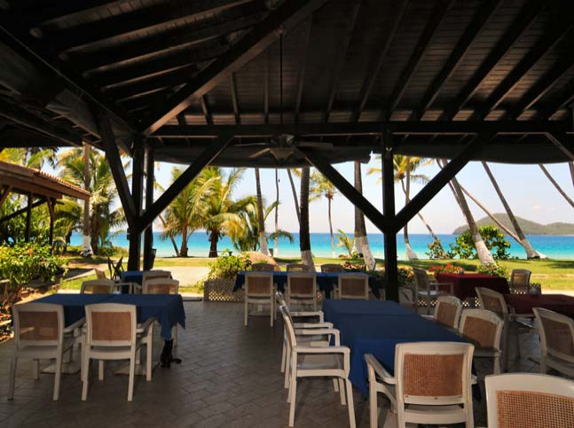
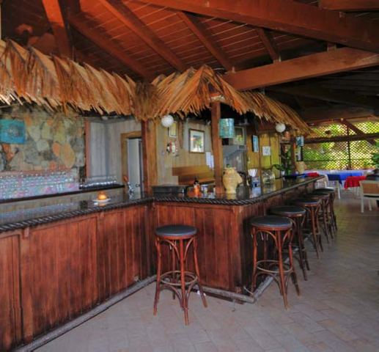
Restaurant and Bar
The restaurant and bar at Lambert Beach Resort are located in a dedicated single storey building close to the beach on the western side of the site a short walk from the hotel reception and car park. The restaurant has an open front giving customers maximum benefit of the beachfront position and views of the beach and beyond to Guana Island.
The Restaurant features:‐
Capacity for 60 plus covers
Bar with seating for up to 12
Breakfast buffet counter and charcoal grill with hot servery
Fully equipped kitchen with preparation, cooking and wash up areas, walk‐in cold and dry stores
Ladies and Gentlemen restrooms

Slide 9
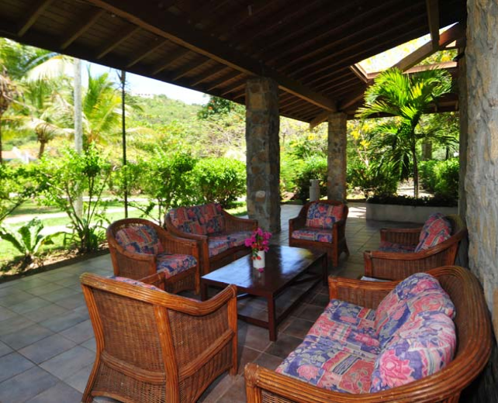
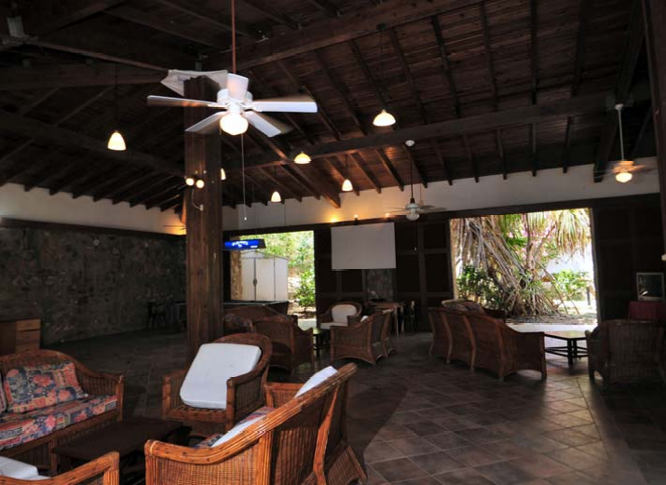
Club House
The Club House is a single storey double height building located between the hotel reception and the restaurant. It is a multi‐use facility able to accommodate meetings and functions (both sit down and receptions) with a maximum capacity of 120 people. It is currently used as a social facility for guests with lounge seating for 20, TV and pool table. The Club House also has an outside covered terrace with lounge seating.

Slide 10
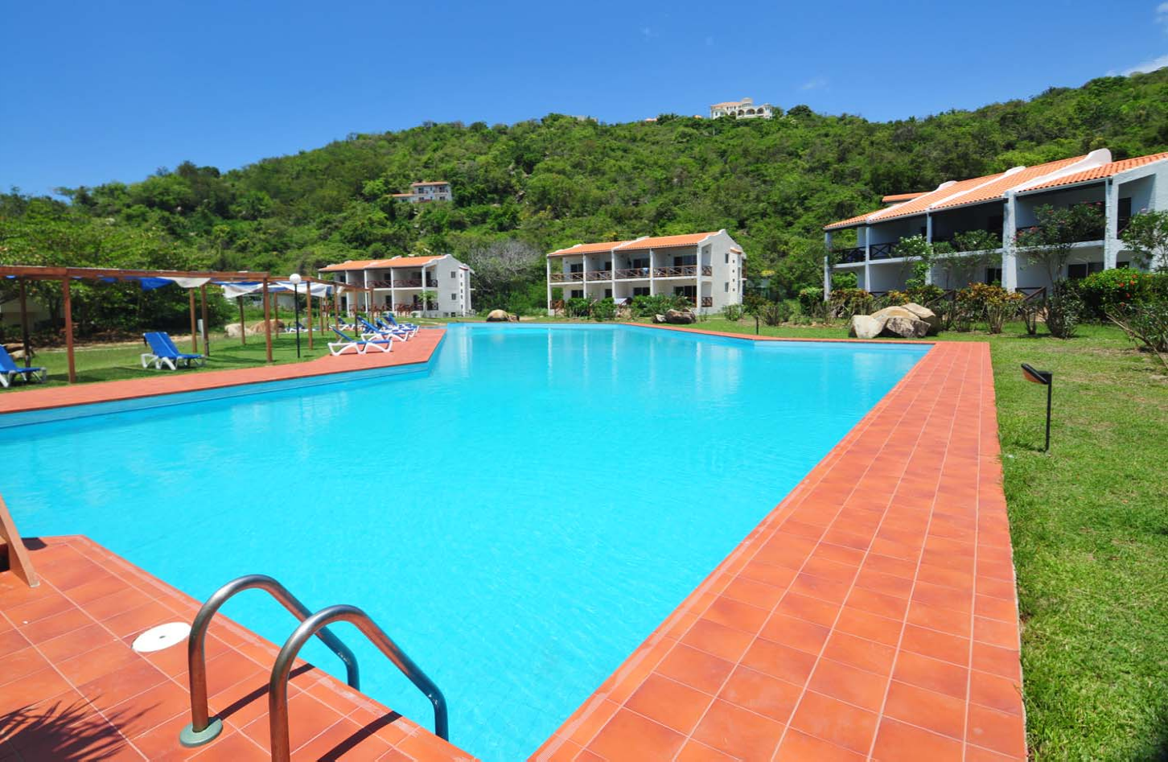
Swimming Pool

Slide 11
Ancillary Facilities
Reception – a single storey building at the main entrance to the Resort with porte cochere and covered outside seating for up to 30 people. The reception building also contains administrative offices and a self contained manager’s apartment (not currently used).
Business Centre – contained within the reception building and with work stations for up to 12 people. Limited IT facilities currently available.
Swimming Pool & Pool Bar – Considered to be the BVI’s largest freshwater swimming pool, it is irregular in shape and measures approximately 170 feet in length and approximately 30 feet in width. The Pool bar has a swim up counter and seating for 14 at stools (8 within the water).
Tennis Court
Car Parking – for approximately 40 cars
Back of House/infrastructure
Reverse Osmosis Plant – supplies desalinated water to the entire resort with a capacity of 15,000 gallons a day. Water (including rainwater) is stored in three main cisterns located under the hotel and condominium buildings.
Generators – Two diesel powered generators provide emergency power to the Resort. The Main generator has an automatic transfer switch and supplies all areas except the restaurant, club house and one of the hotel guestroom buildings. These areas are supplied by a secondary manual start generator.
Laundry – Main laundry with two washers and two dryers for all hotel needs including sheets, towels, and restaurant linen. Two guest coin operated laundry areas are also available.
Waste Water/Sewage Treatment – Two lifting stations serve the hotel and condominium units feeding through to a central septic tank.

Slide 12
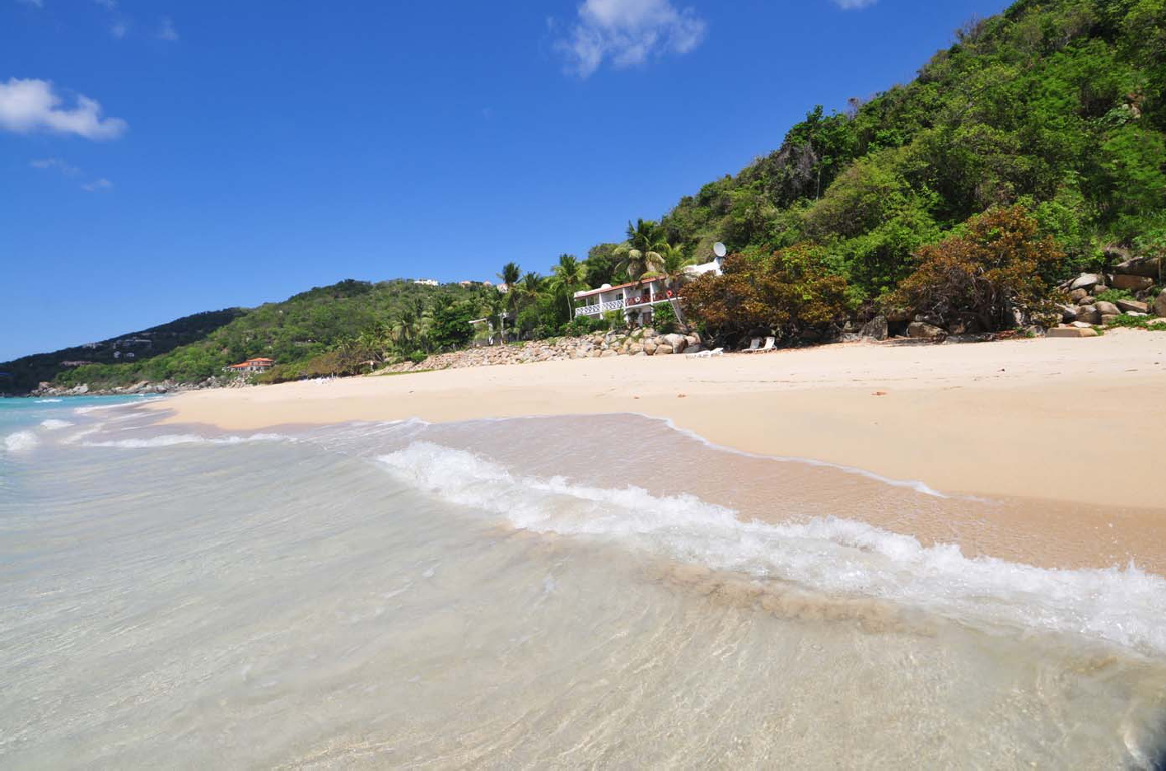
Lambert Beach and Condo ‘B4’ (units 406 & 407 included in sale)

Slide 13
Lambert Beach Resort Villas
There are five villas that have been developed and remain owned as part of the resort. Three of the Villas below are rented with two vacant and available to rent. A sample lease for the villa rentals is available on request.
Villa C1 (Parcel 285) – Available to rent
A two bedroom villa constructed in 2006 located in an elevated position on the eastern side of the property with panoramic sea views. The villa has approximately 878 square feet of living space and Management are seeking to lease Villa C1 for a monthly rent of $2,500.
Villa D2 (Parcel 277) – Available to rent
A three bedroom villa with private swimming pool constructed in 2005. Villa D2 has a prime central elevated position with views of the beach and Guana Island. The villa has approximately 1,431 square feet of living space and Management are seeking to lease the property for $3,500 per month.
Villa E1 (Parcel 319) – Leased
A three bedroom villa with private swimming pool constructed in 2005. The villa is located on the eastern side of the property on the hillside overlooking the beach. Villa E1 has approximately 1,937 square feet of living space and is currently let at a rent of $2,500 per month.
Villa 28 (Parcel 365) – Leased
A four bedroom villa with private swimming pool constructed in 2007 and providing approximately 3,062 square feet of living space. The villa has been built in an enviable position located on elevated ground above the beach on the far eastern side of the property. Accordingly it has superb views of the beach and coastline beyond. Villa 28 is currently let at a rent of $4,200 per month.
Villa 38 (Parcel 347) – Leased
A three bedroom villa constructed in 2007 located on the eastern side of the property on the hillside overlooking the beach. Villa 38 has approximately 1,720 square feet of living space and is currently let at a rent of $3,500 per month.

Slide 14
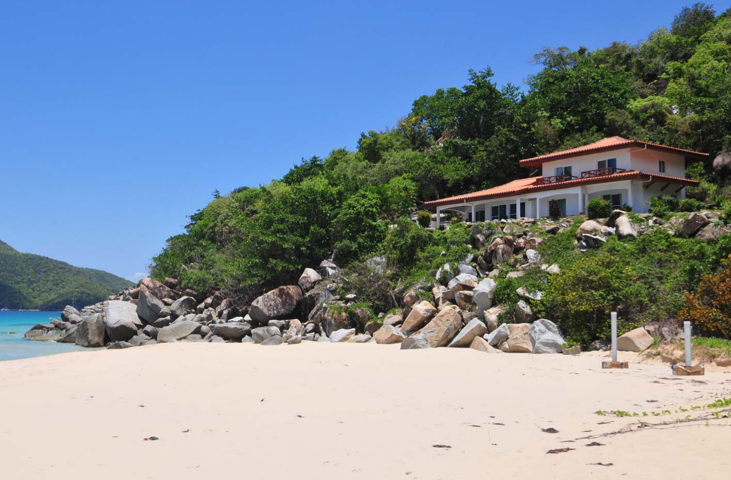
Villa 28 – four bedroom villa overlooking the beach included in the sale.

Slide 15
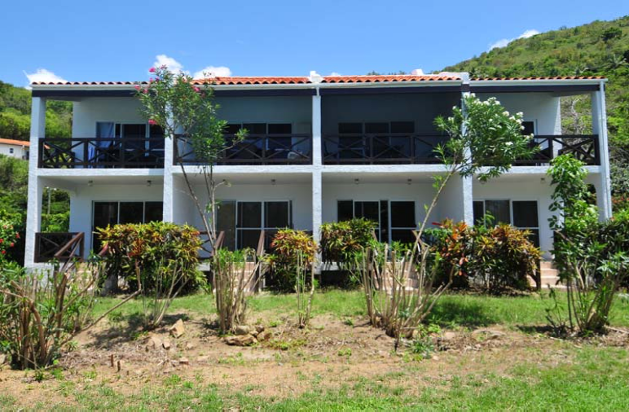
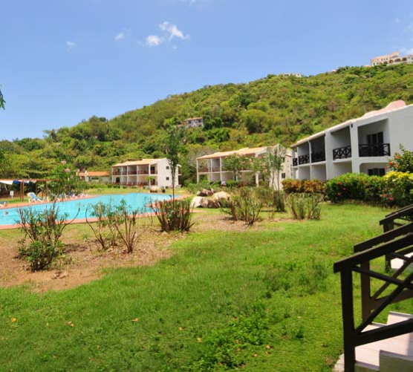
Lambert Beach Resort Condominiums
The original plan for the resort included the development of condominiums (‘condos’) for sale to third parties with a pooling agreement to allow the units to be rented as part of the hotel when not required by the condo owner. Between 2001 and 2006 ten buildings were constructed in two areas of the resort. Two blocks were built on the western side of the resort on beachfront land with the remaining units built to the rear of the hotel and swimming pool area. 33 condos (of a total 60) remain in the ownership of the resort and are either let as part of the hotel inventory or on a long term basis as per the villas above. The opportunity still exists to incorporate all of the condo units including those owned by third parties into a rental pool for the hotel to increase capacity and thereby the income earning potential of the resort. A summary of the units owned is over the page:

Slide 16
Building | Units | Type | Status | Rental Income
A1 | 4 | 2 ‐ suites | vacant | n/a
 |  | 2 ‐ studios
A2 | 5 | 2 ‐ suites | 3 ‐ leased | $1,400 per month from 3 units
 |  | 3 ‐ studios | 2 ‐ vacant
A4* | 2 | 1 ‐ suite | hotel use | n/a
 |  | 1 ‐ studio
B1 | 1 | suite | vacant | n/a
B4 | 2 | 2 ‐ studios | hotel use | n/a
B6 | 1 | suite | vacant | n/a
B9** | 8 | 8 ‐ studios | 8 ‐ leased | $7,200 per month from 8 units
B10** | 8 | 8 ‐ studios | 3 ‐ leased | $3,000 per month from 3 units
 |  |  | 5 ‐ vacant
Basement B8 | 1 | studio | vacant | n/a
Basement B10 | 1 | studio | vacant | n/a
Total | 33
* Units 410 and 411 in Building A4 have been sold to a third party subject to contract. At time of writing title in these units has not been transferred.
** Buildings B9 and B10 are the only condo buildings wholly owned by the resort.

Slide 17
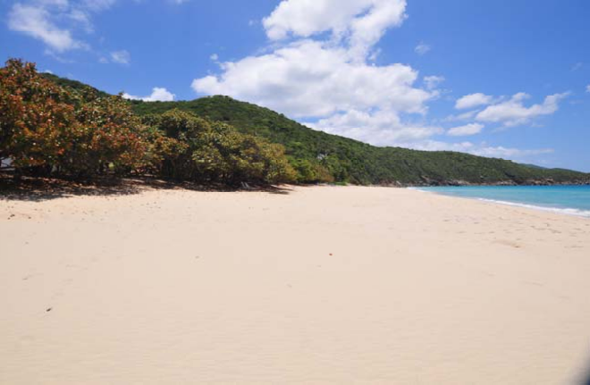
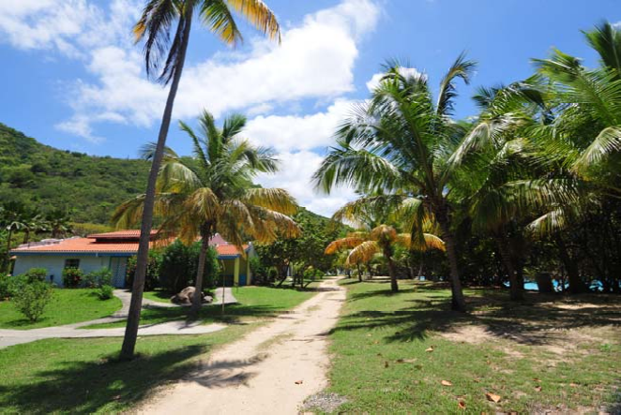
Development Land
Lambert Beach Resort comprises a freehold land and contained within this ownership are 45 allocated lots (including Parcel 316) which have yet to be developed and measure approximately 27.6 acres.The undeveloped lots are located throughout the property and due to the topography of the land each lot has sea views. This development land provides a new owner with a number of development opportunities to enhance the existing resort and facilities as well as generating income through the development and sale of house sites. A list of the undeveloped lots in included in the parcel summary in the Appendices.
Please note Parcel 316 has been sold subject to contract but at the time of writing the title has not been transferred.

Slide 18
British Virgin Islands Guide
Government
The British Virgin Islands is one of five remaining British Overseas Territories in the Caribbean region. The Territory operates a parliamentary and ministerial system, where the House of Assembly administers locally enacted legislation and authorizes all public expenditure. The House of Assembly consists of thirteen legislators, four of whom are elected territory wide and the remaining nine are elected by districts. Under the Virgin Islands Constitution Order 2007, the leader of the Government is now referred to as the ‘Premier’. The members of the Cabinet under the ministerial level are nominated by the Premier and appointed by the Governor. There is a modern judicial system and the highest court of appeal is the Privy Council of the United Kingdom. The Crown is represented by the Governor, who is appointed by the Foreign and Commonwealth office of the United Kingdom and who has reserve powers relating to defence, foreign affairs, the police force and the judiciary.
Currency
The US Dollar is the legal tender in the British Virgin Islands, only one of two islands in the Caribbean which enjoys this status. There are no currency controls.
Economy and Employment
The BVI has experienced considerable economic growth during the past forty years, due to the expansion of the tourism sector and, since the 1980s, the financial services industry. There has been virtually no unemployment for the past decade. However, with the recent global economic constraints, while redundancies increased in various employment sectors, particularly the tourism industry, in 2009 many of the workers made redundant were able to find alternative employment. The official Government figures indicate that the underlying unemployment level remained static through 2008 at 3.1% of the total workforce.
The overseas workforce is controlled through annual work permits with each job taken by an overseas employee advertised locally for the benefit of British Virgin Islanders. The Government is in the process of reviewing the work permit procedure with time limited work permits being the major change under scrutiny.
The following table shows the main employment by business sector in the British Virgin Islands between 2002 and 2008.

Slide 19
Owner
The owner of the entire property is a limited company registered in BVY. Shareholders of this company are another two companies registered in Republik of Panama and their shares are un-nominal.
The buyer will buy from the owner family directly only shares and will save the tax on property required in case of selling/buying plots ( land or house ), aprox. 12% from transaction price
Offer
The entire property which include the hotel and his amenities, condo units, villas, land plots and beach has a total market value of 26,819,000.00 usd as it’s presented locally for sale ( hotel and amenities are not presented for sale yet)
Owners consider the option of selling the whole property, despite the fact that they started a project of general renovation and refurbishing which will increase its value in the future.
The asking price for the whole is 21,000,000.00 usd.

Slide 20
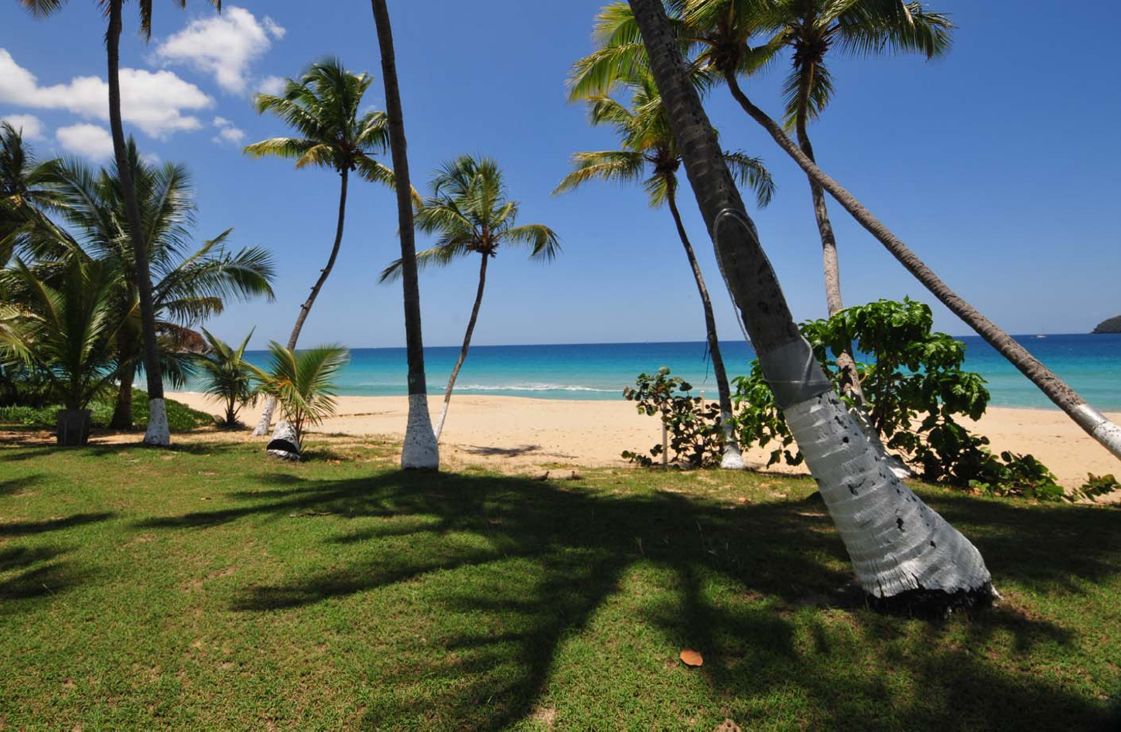
Contact
Simion Iulian Liviu
Phone: 0040744501964
Email: simion.iulian.liviu@gmail.com

